Slide 1
INTRODUCTION TO TUTUM
By
Aqsa Fatima

Slide 2
What we cover in this presentation
Tutum – as a part of Docker
Orchestration-as-a-Service
Containers-as-a-Service
Three essential elements of Tutum
Basic set up Instructions
Tutum Features and advantages
Container Platform
Conclusion

Slide 3
TUTUM IN DOCKER
Containers are lightweight, fast, and portable building block. Tutum allows you to build, deploy, and manage these containers.
Tutum is Docker’s Software as a Service offering for deploying and managing Dockerized distributed applications.
It integrated everything we need to build and run distributed applications in any cloud.

Slide 4
Orchestration-as-a-Service
In IaaS world, we have limitless choices for cloud and infrastructure providers but the choice of our providers limits how we deploy, manage and scale our application.
Tutum decouples the orchestration layer from the underlying infrastructure on which your application runs.
Tutum works on top of any infrastructure provider and users can choose the provider that best satisfies their requirements.
Tutum orchestrates the underlying infrastructure and your containerized applications. In this regard, Tutum is OaaS (Orchestration-as-a-Service).

Slide 5
Containers-as-a-Service
PaaS gives us a way to abstract infrastructure and make deploying applications easy. The “basic building block” of PaaS is code.
PaaS is very rigid with how you write your code and what services you’re able to use with your application. It is a locked-down experience, that’s optimized to satisfy only very specific use cases.
Tutum’s “basic building block” is the container.
Tutum can be referred to as Containers-as-a-Service or CaaS.
Using Tutum means you never have to worry about being locked in to just one infrastructure provider.

Slide 6
Three essential elements of Tutum
Tutum is Docker's SaaS offering for deploying and managing Docker in production. Tutum consists of three essential elements:
Nodes – its where Docker container lives. Through Tutum, we can deploy nodes across all clouds, as well as our own private node on our physical structure.
Services – Group of containers of the same type. Services make it simple to deploy our application across multiple nodes. This helps us scale our application, create secure links between containers and keep our applications running across multiple clouds.
Stacks - stacks can be important to orchestrate deployments of multi-service distributed applications. They are defined by a simple yaml file that we create allowing us to deploy and configure multiple services. They can be shared on stackfiles.io

Slide 7
Basic set up Instructions: 1. Deploying Nodes
For the first time we use Tutum, it provides a walk through tour with all steps to go through for distributed application lifecycle. It helps you build ship and run an application.
Deploying first node:
A node is an individual Linux host used to deploy and run your applications. Tutum does not provide any hosting services, which means all of your applications, services, containers, etc. run on your own hosts.
Before creating a node, we need to link to a Cloud Provider.
When launching a node from a cloud provider you'll actually be creating node clusters. Node Clusters are logical groups of nodes of the same type and from the same cloud provider.

Slide 8
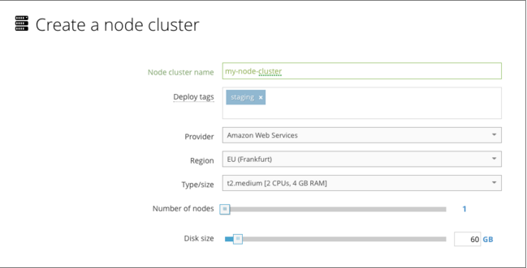
Contd..
After you have linked your cloud provider account, go to the Nodes tab and click on Launch new node cluster. You'll be taken to the wizard to launch your node cluster.
When creating a node cluster we have to give in some basic details such as name, provider, tags (for management and targeted deployments).

Slide 9
2. Deploying Services
Now we have to deploy services. Services are logical group of containers that perform the same task.
With Tutum, we can create a service based on public repository like those found on Docker Hub, Private repositories or choose from jump starts which are preconfigured images specifically designed to work with Tutum out of the box.
After selecting image, we will be asked to choose deployment strategy and which nodes to deploy to. It also provides more advanced options

Slide 10
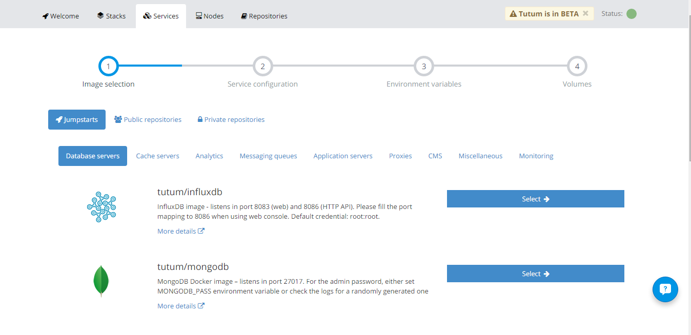
Contd..

Slide 11
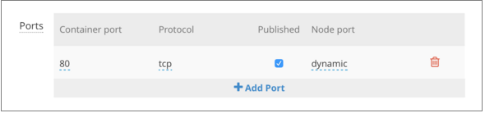
Contd..
Publishing a port
Since we intend to access this container over the Internet, we first need to publish a port. By default, ports are not accessible publicly
Tutum will now send you to the Timeline inside the Service's detailed view.

Slide 12
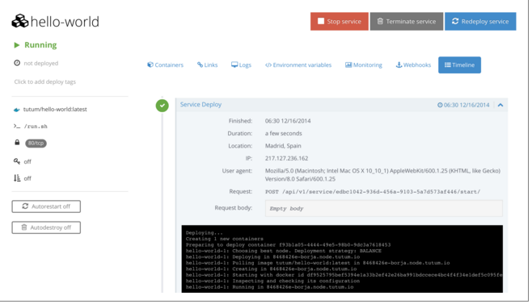
Contd..
this is what the interface will look like:

Slide 13
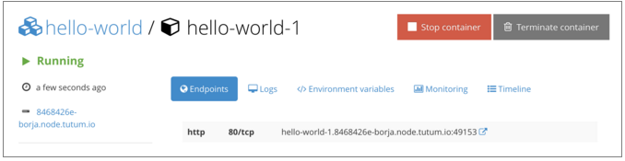
Contd..
Clicking on the container's name takes you to the Container's detailed view (see below). In there you'll get additional information about the containers, such as endpoints, logs, monitoring, etc.

Slide 14
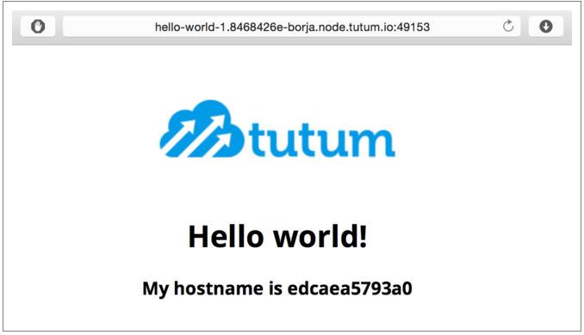
Contd..
Clicking on the link (square and arrow icon) to the right of the endpoint will open a new tab on your browser and display the webpage that our container is hosting.

Slide 15
Features: 1. API Roles
An API role is a set of privileges granted to the service containers to access the Tutum API.
Tutum currently offers a HTTP REST API and a Websocket Stream API which are used by both the Web UI and the CLI.
At the moment, Tutum only supports a "global" role which allows any operation to be performed on the API if granted.

Slide 16
2. Automated Builds
Tutum can automatically build images from GitHub repositories. To enable this, you must follow these steps:
Link your GitHub account
Create an empty repository in Tutum's registry
Edit the repository to configure the source GitHub repository and the source branches for each repository tag to be built
Once your repository is configured, a git push to a branch which has been set as a tag source will trigger a build.

Slide 17
3.Automated Testing 4. Auto Destroy
Tutum can automatically test your GitHub repositories using containers.
Autodestroy is a Tutum feature that when enabled on a service, will automatically terminate containers when they stop (destroying all data within the container). This is useful for on-off actions which store results in a external system.
If Autorestart is activated, Tutum will evaluate whether to try restarting the container or not before evaluating Autodestroy.

Slide 18
Container platform
From within Tutum you can manage nodes (Linux hosts on which your containers run) from your infrastructure provider of choice, as well as deploy, manage, and orchestrate Docker containers.
Tutum's goal is to accelerate the development and simplify the ops workflows using containers.
Tutum helps you from the moment you have code written, and empowers you to build (docker image, continuous integration), deploy (IaaS/container orchestration, continuous deployment/delivery, storage, networking, security, etc.) and manage (logs, monitoring, scaling, etc.) your applications across any cloud.

Slide 19
Conclusion
The objective of Tutum is to become a complete container platform on which to build, deploy and manage your containerized applications. The end goal is to provide a service that is simple, but does not compromise on control and flexibility.
This latest acquisition does however bring up a number of questions for the container community and the Docker ecosystem. Docker will have to rationalize a number of its existing projects - for example, Orca (Docker's homegrown top-to-bottom integrated stack project) versus Tutum, Socketplane (the SDN startup acquired by Docker in March, set to deliver Docker-native networking) and Weave (the networking stack currently used in Tutum), as well as Tutum's private registry versus the one already in use by Docker.

Slide 20
Thank You

Slide 21
References:
https://support.tutum.co/support/solutions/5000023449
https://hub.docker.com/

